Slide 1

Encryption & Hashing
Notes:
Just into on why we’re here today and what’s the point of having this presentation. Brifely touch the topic of presenters: SZ, OZ, IL, and KK.
In the end: passing the floot to Sviatlana.

Slide 2
Encryption
Encryption – is a means of securing digital data using one or more mathematical techniques, along with a password or "key" used to decrypt the information
Caesar cipher:
A
B
C
D
E
F
G
H
I
J
Key = 3
…
A
B
C
D
E
F
G
H
I
J

Slide 3
Where do we protect the data?
Data can be protected in 3 different places:
In transit – when we make request from one server to another, it should be encrypted. TLS/SSL, HTTPS
At rest – when the data is stored on disk. AES256
In use – some advanced algorithms allow you to perform simple computations on encrypted data

Slide 4





Encryption types
Symmetric encryption – uses the same key to encrypt and decrypt
Secret key
Secret key
Asymmetric encryption – uses different keys to encrypt and decrypt
Public key
Private (secret) key

Slide 5
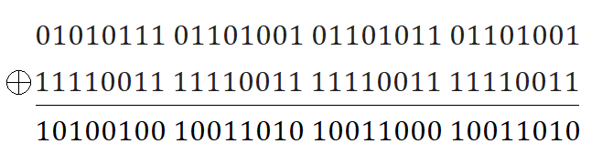
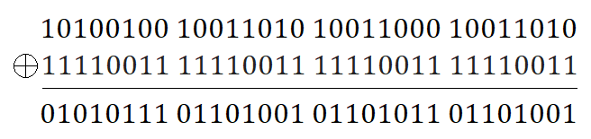
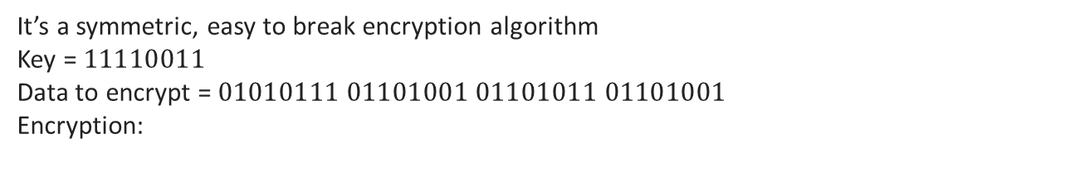
XOR Encryption
It’s a symmetric, easy to break encryption algorithm
Key = $11110011$
Data to encrypt = $01010111 01101001 01101011 01101001$
Encryption:
Decrypt:

Slide 6
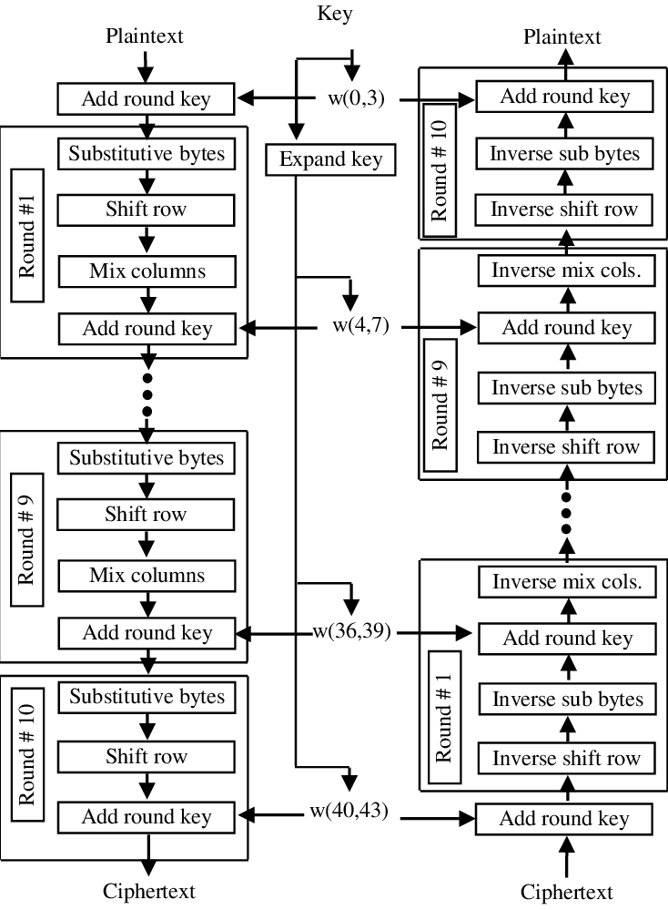
AES
AES – Advanced Encryption Standard. Family of symmetric bulk encryption algorithms
Include
AES-128
AES-192
AES-256
Bult encryption means that data is encrypted in blocks of the same size as key (128, 192, 256 bits respectively)

Slide 7
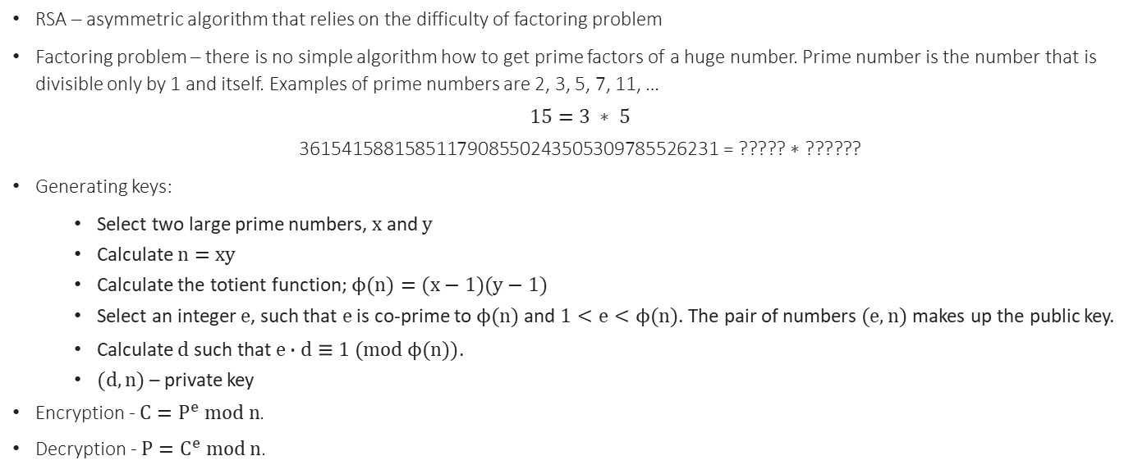
RSA
RSA – asymmetric algorithm that relies on the difficulty of factoring problem
Factoring problem – there is no simple algorithm how to get prime factors of a huge number. Prime number is the number that is divisible only by 1 and itself. Examples of prime numbers are 2, 3, 5, 7, 11, …
$$15=3 ∗ 5$$
$$\text{3615415881585117908550243505309785526231}\text{ = ????? ∗ ??????}$$
Generating keys:
Select two large prime numbers, $x$ and $y$
Calculate $n=xy$
Calculate the totient function; $ϕ(n)=(x−1)(y−1)$
Select an integer $e$, such that $e$ is co-prime to $ϕ(n)$ and $1<e<ϕ(n)$. The pair of numbers $(e,n)$ makes up the public key.
Calculate $d$ such that $e∙d≡1 (mod ϕ(n))$.
$(d, n)$ – private key
Encryption - $C=P^{e} mod n$.
Decryption - $P=C^{e} mod n$.

Slide 8
Encryption types
Key Differences | Symmetric Encryption | Asymmetric Encryption
Number of keys | Single key for encryption and decryption. | Two keys for encryption and decryption
Security | Less secured due to use a single key for encryption. | Much safer as two keys are involved in encryption and decryption.
Key Lengths | 128 or 256-bit key size. | RSA 2048-bit or higher key size.
Confidentiality | A single key for encryption and decryption has chances of key compromised. | Two keys separately made for encryption and decryption that removes the need to share a key.
Speed | Super fast | Much slower
Algorithms | AES, DES | RSA
Data size | Used to transmit big data. | Used to transmit small data.
Resource Utilization | Symmetric key encryption works on low usage of resources. | Asymmetric encryption requires high consumption of resources.

Slide 9



TLS
TLS uses both asymmetric and symmetric encryption. Asymmetric is used to establish a secure session, and symmetric encryption is used to exchange data within the session. A website must have an SSL/TLS certificate for their web server/domain name.
The client contacts the server using a secure URL (HTTPS…)
The server returns its certificate and public key
The client verifies this with a Trusted Root Certification Authority
The client and server negotiate the strongest type of encryption that each can support
The client encrypts a session secret key with the server’s public key and sends it to the server
The server decrypts the secret key with its private key, and the session is established.
The session key (symmetric encryption) is now used to encrypt and decrypt data transmitted between the client and server.
Decrypt secret key with private key
Generate secret key & encrypt it
Send encrypted key
Certificate, public key
Exchange data
https://host/...
Encryption algorithm
Server’s public key
Secret key
1. Secret key
Validate Cert & key

Slide 10
Best practices
Use data encryption in transit and at rest
Use popular algorithms, they are well-checked
Protect the access to your secret keys
Don’t invent the bicycle

Slide 11
QA
Do you have any questions on encryption?

Slide 12
Hashing
Hash function usually has fixed length output
Hash functions are usually one-way, you can’t decrypt it
Hash functions have collisions
Hash functions often have avalanche effect
Text
Hashing function
Hash
Hashing usage:
Message digest
Password verification
Data structures like hash map

Slide 13
Password verification
Storing passwords in plaintext in insecure
Storing MD5 or SHA256 hashes of passwords is insecure too due to rainbow tables
Source | MD5 hash
12345678 | 25d55ad283aa400af464c76d713c07ad
password | 5f4dcc3b5aa765d61d8327deb882cf99
123123123 | f5bb0c8de146c67b44babbf4e6584cc0
qwertyqwerty | 12478e7ad0e39aa9c35be4b9a694ba9b

Slide 14
Password salting
A salt is random data that is used as an addition to a password for hashing. A new salt is randomly generated for each password. Typically, the salt and the password are concatenated and fed to a hash function, and the output is stored with the salt in a database.
Source | Salt | MD5 hash
12345678 | kigjh3o9 | f08bd3c58c83f1487a1df1e8fc6b0cce
password | 9vm-lroz | a3a9d1b112cedee53c45f2e6caf34887
123123123 | o!mt58ca | 557671d1a066ab244ea13fba4d393bb5
qwertyqwerty | jd)k19a3 | 23d0a79ec59e049c7c10630a40633b09

Slide 15
Modern algorithm
BCrypt:
Incorporates salt automatically, protecting from the rainbow table attack
Speed of the algorithm is controlled by “rounds” parameter. Algorithm can be made very slow to prevent brute force attacks
Each hash is different, check is done not by simple string comparison

Slide 16

Digital signature
A digital signature is a mathematical scheme for verifying the authenticity of digital messages or documents. A valid digital signature gives a recipient very high confidence that the message was created by a known sender, and that the message was not altered in transit.
Prerequisites:
1. Issue a signature at Certificate Authority. Signature consists of 2 keys. Private is used to sign documents, public for their validation
Certificate Authority
Public key
Private (secret) key

Slide 17


Digital signature
Signing process:
Take a hash of the file that you would like to sign
Encrypt that has using your private key
Bundle file, encrypted hash and public key and send them to the receiver
Private (secret) key
Hash
Encoded hash
Signed document

Slide 18
Digital signature
Validate
Certificate Authority
Decrypt
Decrypted Hash
Validation process:
Receiver should validate your public key at Certificate Authority
Receiver decrypts hash using public key and checks if it matches the file
Hash
Decrypted Hash
Compare

Slide 19
QA
Do you have any questions?

